Slide 1

VI-84: Tech Titans: Vision Custom Reports
Best Practices and Sample Report

Slide 2
Agenda
Overview
On Premise vs. In The Cloud
Getting Started With the Vision Report Template
Creating The Report Statement (SQL)
Using The Selection Feature
Adding Custom Parameters
Using The Column Selection Feature In Report Options
Using The Sorting / Grouping Feature In Report Options
Other Custom Properties And Report Features

Slide 3
On Premise vs. In the Cloud
Installing and uploading your custom reports

Slide 4
Adding reports to an On-Premise installation
Reports must be copied to a specific folder on the Vision Application Server
Usually [C:\Program Files (x86)\Deltek\Vision\Reports\Custom\<Info Center>] or [C:\Program Files (x86)\Deltek\Vision\Reports\Custom\My Reports\<Info Center>]
You can add custom reports to any report section available to you (Project, Employee, Client, Contact, Vendor, Billing, etc…)
There are no naming conventions for the report file itself but we suggest to follow the Cloud Naming Convention: <Your 10 digit client number>_<Your Report name>.rdl (e.g.: 0000012345_MyCustomReport.rdl)
Open Vision and go to [Utilities] – [Report Administration], select [Custom] in Type and upload all or specific report files by using a filter in the Report Name field (e.g. “0000012345*”) and then click “Load Report Files”

Slide 5
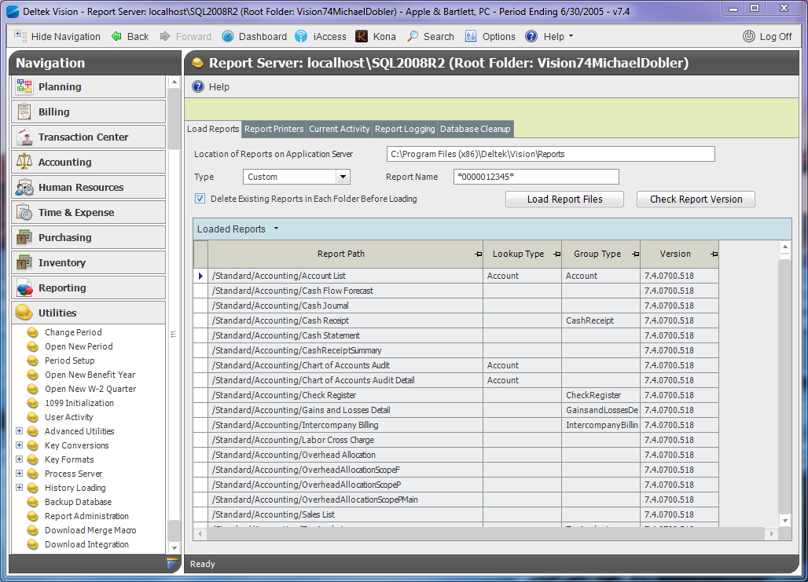
Adding reports to an On-Premise installation
Utilities
Folder Location
Report Admin
Report Name Filter (empty if all)
Type
Upload Button (will stop Reporting Services!)

Slide 6
Adding reports to a Cloud installation
Reports can be uploaded directly from your local machine to the cloud
If you want to upload a new version of an existing report, delete this report first and save before trying to upload the new version
Use the [Upload] button to select a report file on your local machine
You must follow the Cloud Naming Convention: <Your 10 digit client number>_<Your Report name>.rdl (e.g.: 0000012345_MyCustomReport.rdl). All other files will be ignored.
Once the file is uploaded and appears in the custom report table, select the appropriate [Location] from the dropdown menu
You can turn on this feature for On Premise installations as well. Check the [SaaS / Hosted Instance] and [Allow RDL files to be uploaded in Report Administration] options in Weblink for this

Slide 7
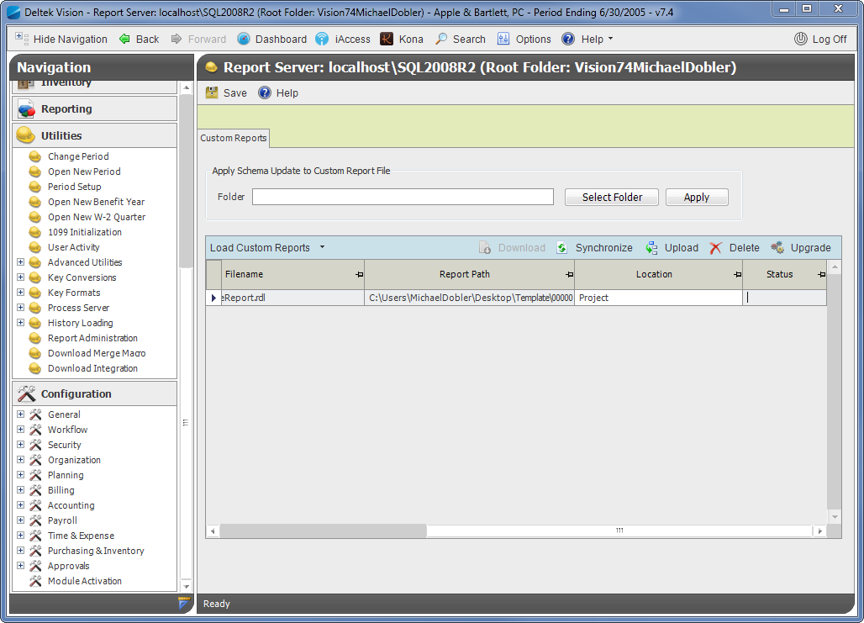
Adding reports to a Cloud installation
Upload report file from local machine
Utilities
Report Admin
Assign proper report location

Slide 8
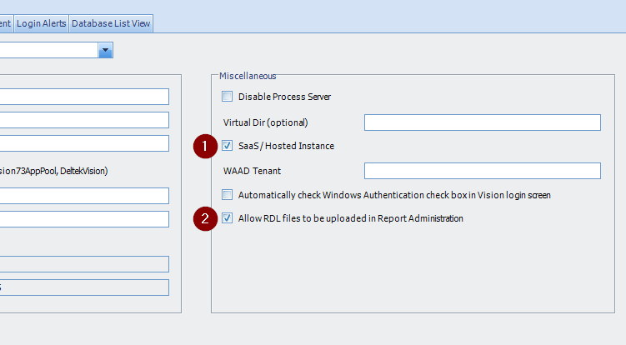
Activating Cloud Report Administration Features

Slide 9
Getting Started With The Vision Report Template
Why we use the template and how to start with Visual Studio 2014/2015

Slide 10
Creating the Visual Studio project
To create Vision 7.4 (or higher) compatible reports (SSRS2010) you must use Visual Studio 2012 or higher
You will need the “Microsoft SQL Server Data Tools – Business Intelligence for Visual Studio 2013” add in. You can download it here:
http://www.microsoft.com/en-ca/download/details.aspx?id=36843 (VS2012)
http://www.microsoft.com/en-ca/download/details.aspx?id=42313 (VS2013)
Create a new project and pick the “Report Server Project” from the [Business Intelligence] – [Reporting Services] template folder.
Select an appropriate name and folder for the solution. We suggest to use some kind of source control system.

Slide 11
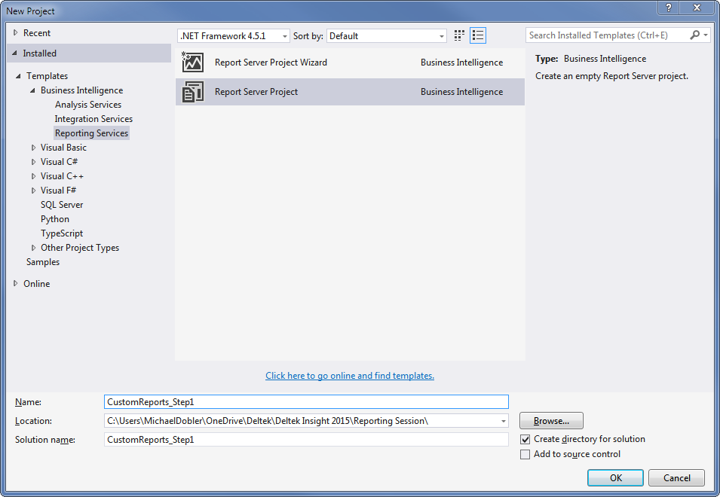
Creating the Visual Studio project

Slide 12
Creating the Visual Studio project
Right click on the [Reports] folder in the Solution Explorer, select [Add] > [Existing Item …] and pick one or more Vision Report Templates from <Vision Installation Directory>\Reports\Template. It is a good idea to copy the complete folder to your development machine. We will be using the “VisionTemplatePortrait.rdl” file for this sample
Add an existing item by right-clicking on the [Shared Data Sources] and pick the “DefaultDataSource.rds” from the <Vision Installation Directory>\Reports folder
Both files have now been copied to your solution folder. Make sure that the files are not “Read-Only”
Change the connection in “DefaultDataSource.rds” to your Vision database
Rename the “VisionTemplatePortrait.rdl” file to “0000000000_InsightSampleReport.rdl”

Slide 13
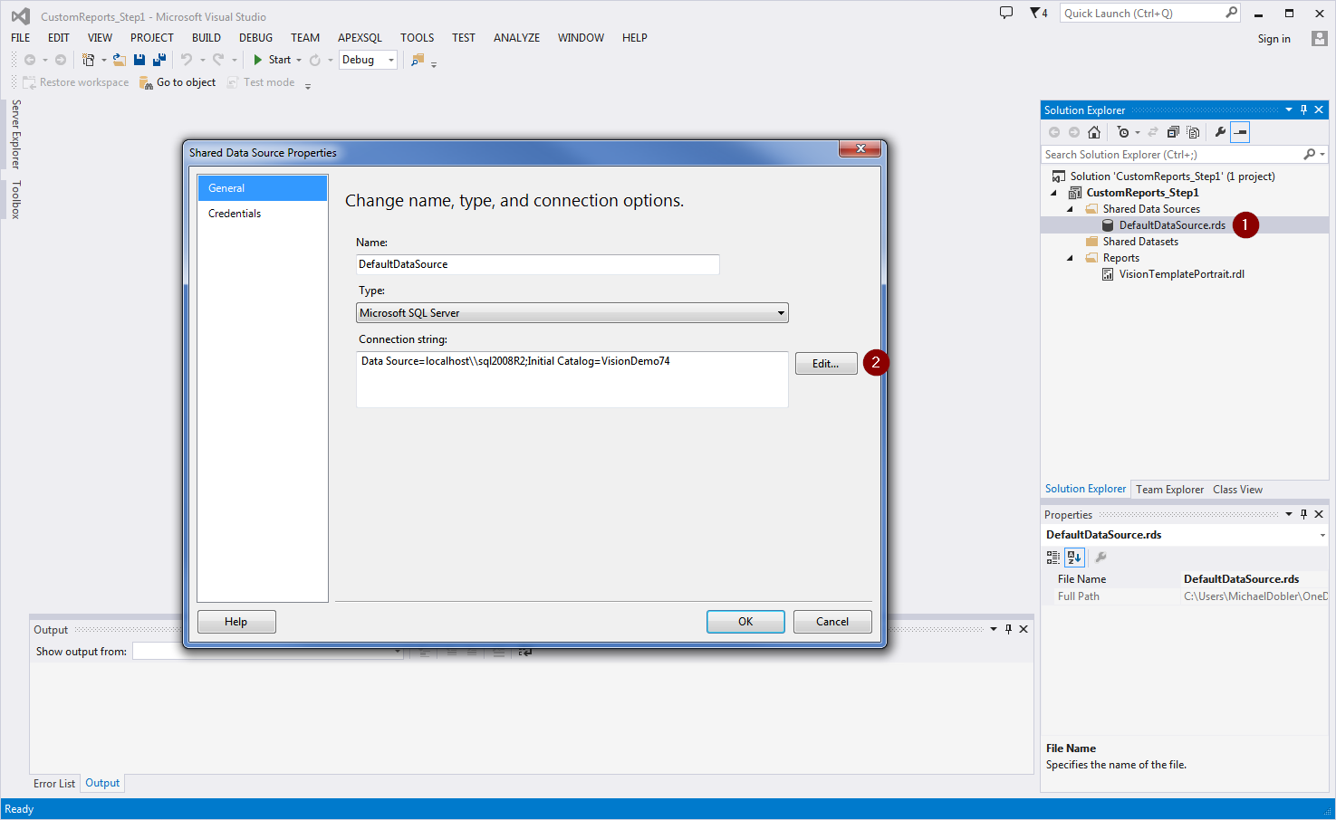

Creating the Visual Studio Project

Slide 14
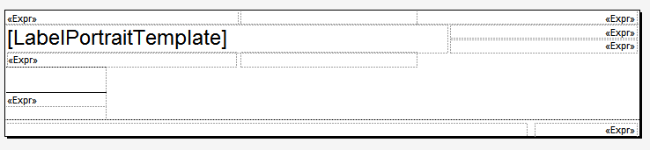
Default Design Elements
The report comes with some predefined elements in the layout
body_ReportName Text Box:
Vision uses any text displayed here as “Report Name” in the reports list(s)
MainTable Tablix:
This is where the result will be rendered. The table comes with a predefined autogrouping column
pagefooter_FooterText Text Box:
Displays company name, etc…
pagefooter_Number Text Box:
Displays Page X of Y information

Slide 15
Default Parameters
Vision provides four default parameters with values when the report is executed through the application. You can use these parameters in your SQL SELECT statement
Parameter Name | Data Type | Description
ActivePeriod | Number | This parameter is used to pass on the currently selected period in Vision
ActiveCompany | Text | This parameter is used to pass on the currently selected company in Vision (if Multicompany is activated); otherwise an empty value is submitted
HeadingStartDate | Date | The start date of the current period
HeadingEndDate | Date | The end date of the current period

Slide 16
Default Custom Properties
Property Name | Sample Value | Description
ReportType | Deltek Insight Sample | This is the name of the report used in Vision. Should match the name in the layout
ResourceFileName | VisionTemplatePortrait | Can be used to create multi-language reports
ReportVersion | 7.4.INSIGHT.01 | Your version number of this report. Will be displayed in the Report Administration screen
LookupType | Employee | Defines which lookup dialog and options will be shown for the Selection window
GroupingType | Employee | Defines which items are available for Auto Grouping. Must match Lookup Type
AutoGroupingQuery | Y | Allows Vision to create custom SQL code for grouping data
OptionForm | Delek.Vision.ReportClient.VisionReportDialog | Specifies which Options Dialog to use. Leave it with the default value
HelpFile |  | Define your own help file for your report (empty by default)
UseColumnSelection | Y | Shows the Columns tab in the Options dialog and lets you show/hide columns in your report
AllowUserDefinedFields | Employees | Allows you to add any User Defined Info Center fields to the report output
AllowCalcFields | Y | Allows you to use calculated fields in the report
Modules |  | You can specify which modules need to be present for this report (e.g. Acct;Billing;ProjCtrl;)

Slide 17
SQL Statement Placeholders
T | Description | Placement in SQL Statement
/***GROUP COLUMNS***/ | Placeholder for the grouping fields selected in the Options dialog | Right after SELECT keyword
/***CUSTOM COLUMNS***/ | Placeholder for the custom fields selected in the Columns tab | After SELECT keyword or Group Col
/***GROUP JOIN***/ | Placeholder for any additional JOIN information needed for the grouping | At the end of the FROM clause
/***WHERE CLAUSE***/ | Placeholder for the filter selection created in the Selection dialog. ONLY USE if there is no default where clause in your statement | Right after the FROM clause if there is no WHERE clause
/***EXTEND WHERE CLAUSE***/ | Placeholder for the filter selection created in the Selection dialog. ONLY USE if there is already a default where clause in your statement | At the end of the WHERE clause
/***GROUP CLAUSE***/ | Placeholder for the grouping selected in the Options dialog. ONLY USE if there is no default group by clause in your statement | Right after the WHERE clause if there is no GROUP clause
/***EXTEND GROUP CLAUSE***/ | Placeholder for the grouping selected in the Options dialog. ONLY USE if there is already a default group by clause in your statement | Right after the GROUP BY keyword
/***ORDER CLAUSE***/ | Placeholder for the sorting selected in the Options dialog. ONLY USE if there is no default order by clause in your statement | Right after the GROUP clause if there is no ORDER clause
/***EXTEND ORDER CLAUSE***/ | Placeholder for the sorting selected in the Options dialog. ONLY USE if there is already a default order by clause in your statement | Right after the ORDER BY keyword

Slide 18
Creating The Report Statement
How to set up a proper SQL Statement as a base for your custom report

Slide 19
Sample Report – Phase 1
As a sample for this session we will build an Employee Report that will show us the following information:
Employee (ID and Name)
Project, Phase and Task Information
The total hours for each employee, project, phase and task
The billable hours of this section, based on the Non-billable Labor Code setup in the Billing Configuration
The non-billable hours based on the setup
The report will be an Employee report
Phase 1 will have no custom options activated and will simply execute the statement

Slide 20
Phase 1 Statement
DECLARE @ActiveCompany varchar( 10 ) = ' '
DECLARE @ActivePeriod int = 200506
SELECT
EM.Employee , EM.FirstName , EM.MiddleName , EM.LastName ,
PR.WBS1 , PR.Name AS ProjectName ,
LEVEL2.WBS2 , ISNULL( LEVEL2.Name , '' )AS WBS2Name ,
LEVEL3.WBS3 , ISNULL( LEVEL3.Name , '' )AS WBS3Name , SUM( LD.RegHrs + LD.OvtHrs + LD.SpecialOvtHrs )AS TotalHours ,
SUM( CASE WHEN LD.LaborCode LIKE CFGBillMain.NonBillLaborCode THEN 0 ELSE LD.RegHrs + LD.OvtHrs + LD.SpecialOvtHrs END )AS BillableHours ,
SUM( CASE WHEN LD.LaborCode LIKE CFGBillMain.NonBillLaborCode THEN LD.RegHrs + LD.OvtHrs + LD.SpecialOvtHrs ELSE 0 END )AS NonBillableHours
FROM
EM
JOIN EmployeeCustomTabFields ON EM.Employee = EmployeeCustomTabFields.Employee
JOIN LD ON EM.Employee = LD.Employee
JOIN PR ON LD.WBS1 = PR.WBS1 AND PR.WBS2 = ' ' AND PR.WBS3 = ' '
LEFT JOIN PR LEVEL2 ON LD.WBS1 = LEVEL2.WBS1 AND LD.WBS2 = LEVEL2.WBS2 AND LEVEL2.WBS3 = ' ‘
LEFT JOIN PR LEVEL3 ON LD.WBS1 = LEVEL3.WBS1 AND LD.WBS2 = LEVEL3.WBS2 AND LD.WBS3 = LEVEL3.WBS3
LEFT JOIN CFGBillMain ON CFGBillMain.Company = @ActiveCompany
CROSS APPLY CFGSystem
CROSS APPLY CFGFormat
WHERE
( CFGSystem.MulticompanyEnabled = 'N' OR SUBSTRING( EM.Org , CFGFormat.Org1Start , Org1Length ) = @ActiveCompany )
AND LD.Period = @ActivePeriod
GROUP BY
EM.Employee , EM.FirstName , EM.MiddleName , EM.LastName ,
PR.WBS1 , PR.Name , LEVEL2.WBS2 , ISNULL( LEVEL2.Name , '' ) , LEVEL3.WBS3 , ISNULL( LEVEL3.Name , '' )
ORDER BY
EM.Employee , PR.WBS1 , LEVEL2.WBS2 , LEVEL3.WBS3

Slide 21
Phase 1 Statement Explained
The base info center tables (EM, EmployeeCustomTabFields) must be the first items in the FROM clause of the statement.
Each project level is added independently to the output (as PR, LEVEL1 and LEVEL2)
The Non-billable Labor Code is stored in the CFGBillMain table (per company)
We only want to see the employees of the current company. The active company code is provided later by Vision, we use the CFGSystem to check if the database has Multi Company enabled and then use the CFGFormat table to see which portion of the Org code is used for the company code.
CROSS APPLY is used instead of JOIN for both the CFGSystem and CFGFormat because these tables only contain one data row

Slide 22
Setting Up Our First Report
In Visual Studio open the “Report Data View”, expand the Datasets element and double click on the ReportDataset item.
For now, copy the complete SQL Statement (excluding the parameter declaration) into the Query field. Click OK.
The system now assigns the report parameters to the query parameters and updates the available fields list for the ReportDataset
Do not delete or overwrite the first column in the MainTable Tablix and add the dataset fields to the Tablix
Save it and upload it to Vision

Slide 23
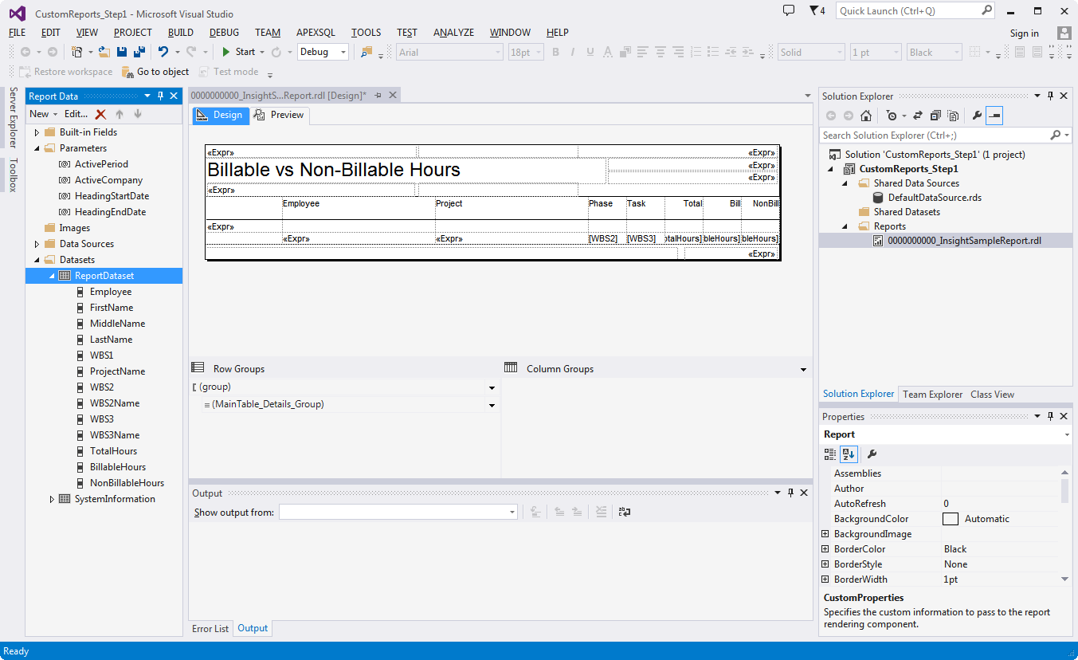
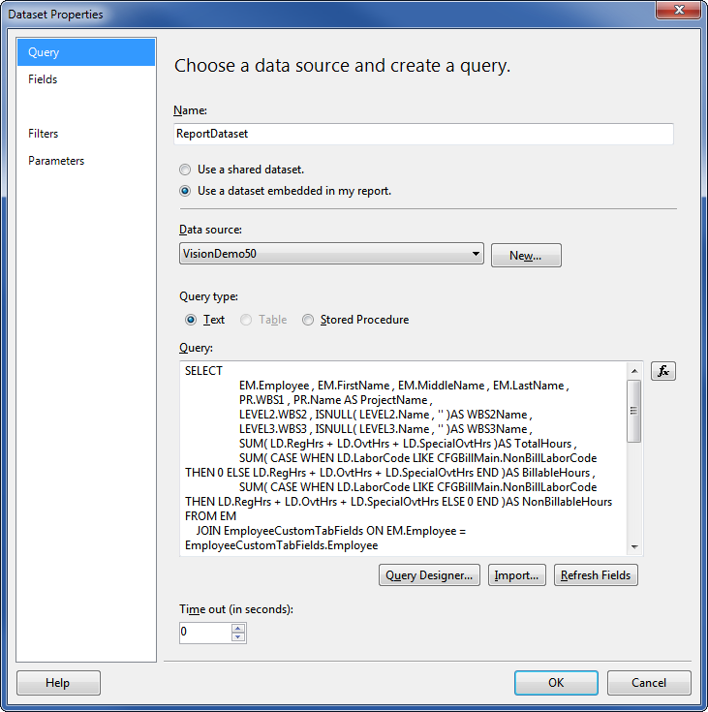
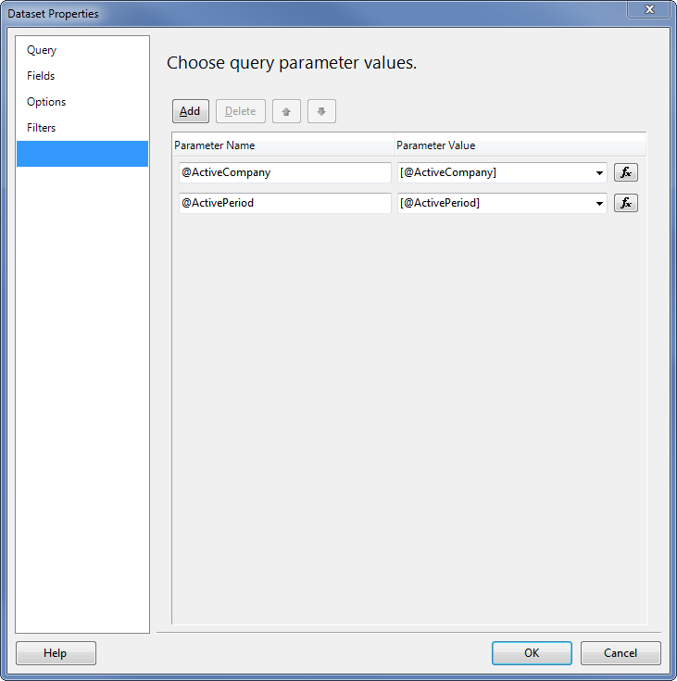
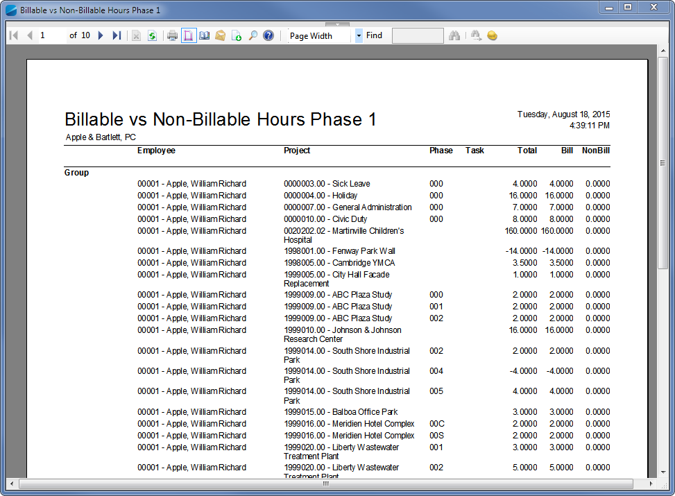
Phase 1 Demo

Slide 24
Using The Selection Feature
How to access and integrate the built-in Selection Dialog

Slide 25
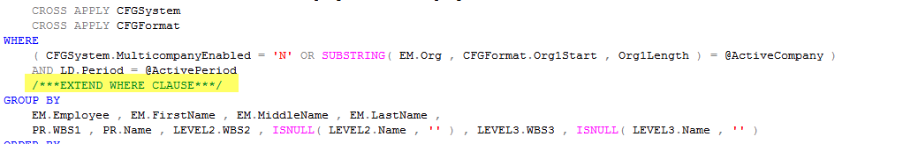
Phase 2 Extensions
Change Name in Design and Custom Properties
Change Report Version
Set LookupType in Custom Properties to Employee
Add the /***EXTEND WHERE CLAUSE***/ Placeholder to the SQL Statement
Upload the report

Slide 26
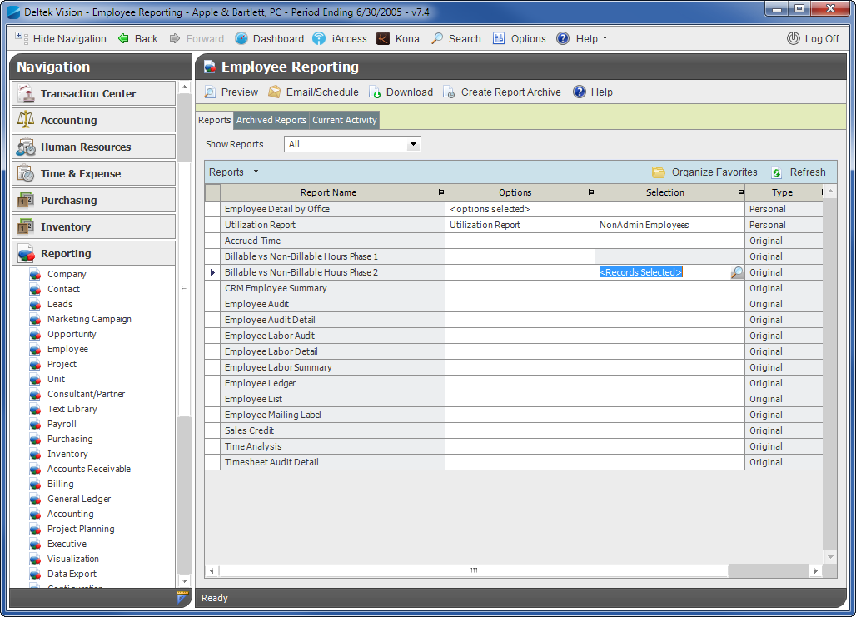
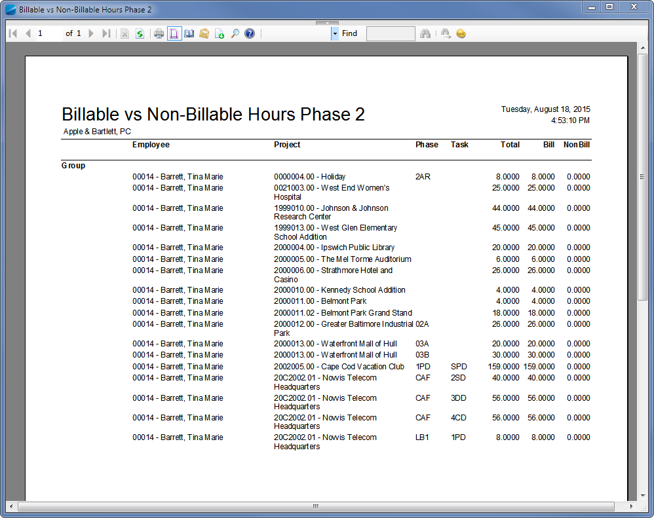
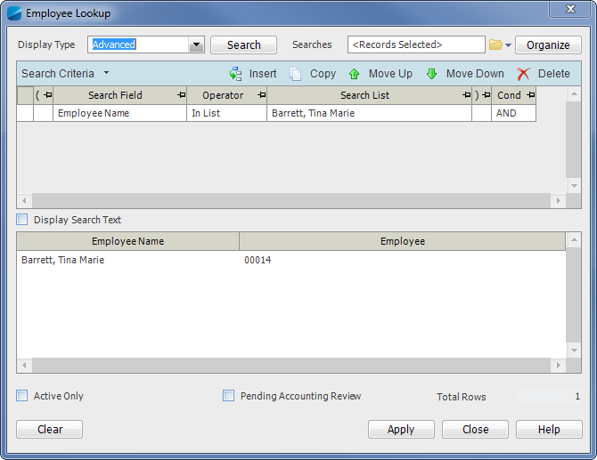
Phase 2 Demo

Slide 27
Adding Custom Parameters
How to define and set up additional parameters for your report

Slide 28
Phase 3 Extensions
We want to add the ability to show Regular Projects Only. We will add a custom check box to the Custom Report Options called “Regular Projects Only”
The option has to be defined in Vision as “RegularProjectsOnly” of type Check Box
In the report parameters it must be added as @CustRegularProjectsOnly of type Text (Vision will send ‘Y’ or ‘N’ as values)
Edit the SQL and add this before the /***EXTEND WHERE CLAUSE***/ Placeholder: AND (@CustRegularProjectsOnly = 'N' or PR.ChargeType = 'R')
Add the /***EXTEND WHERE CLAUSE***/ Placeholder to the SQL Statement
Upload the report

Slide 29
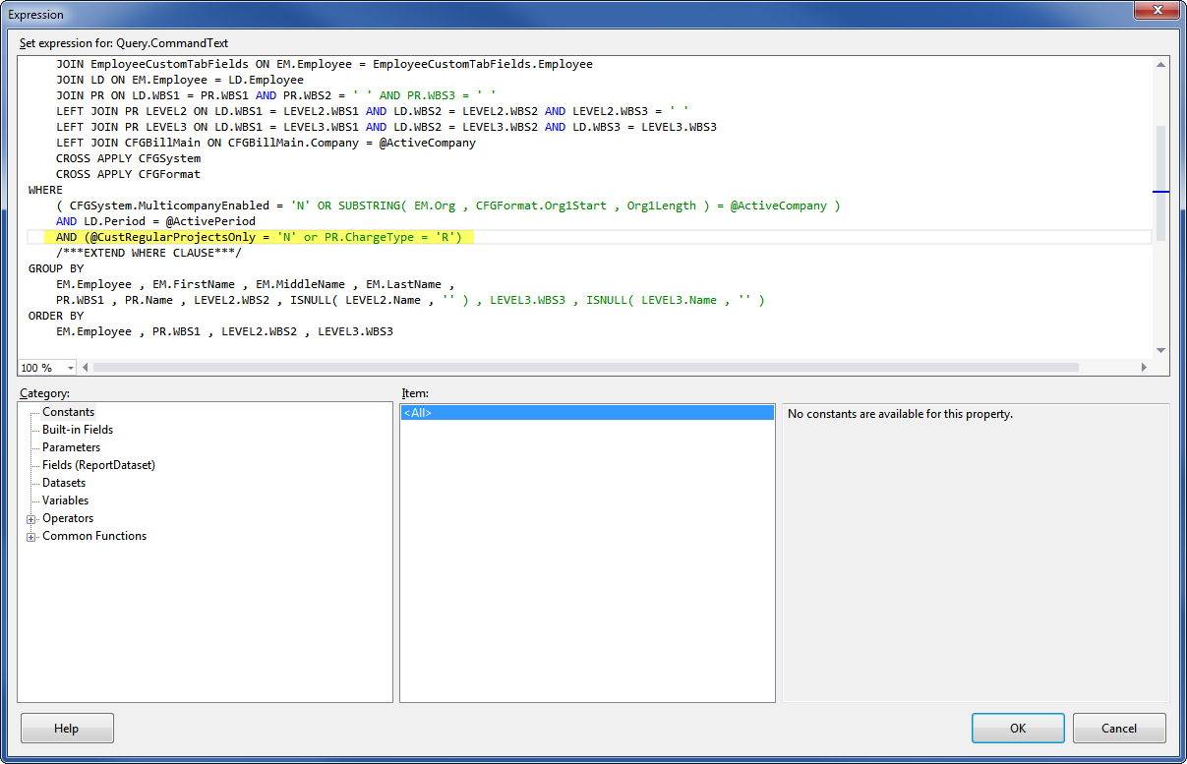
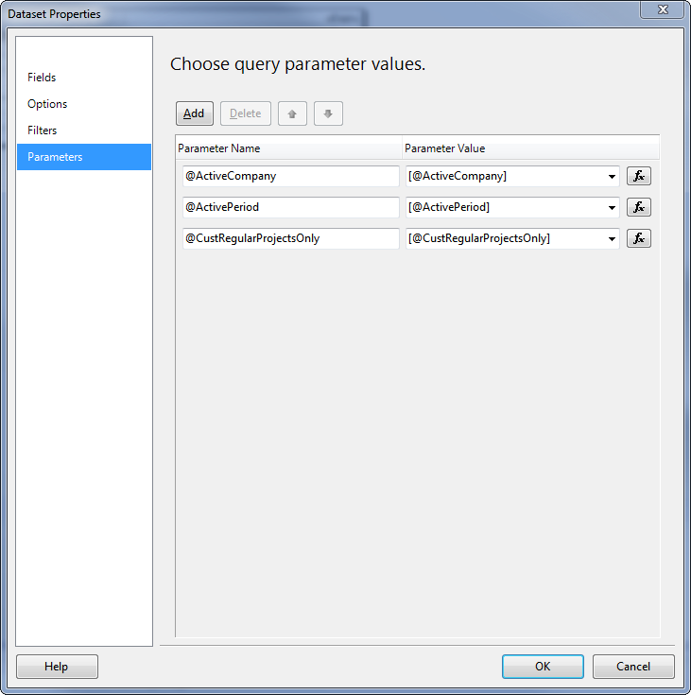
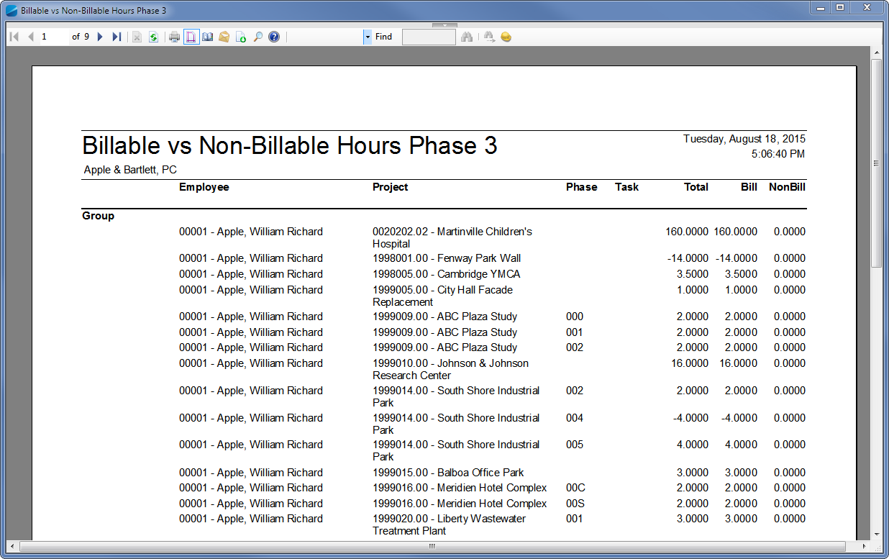
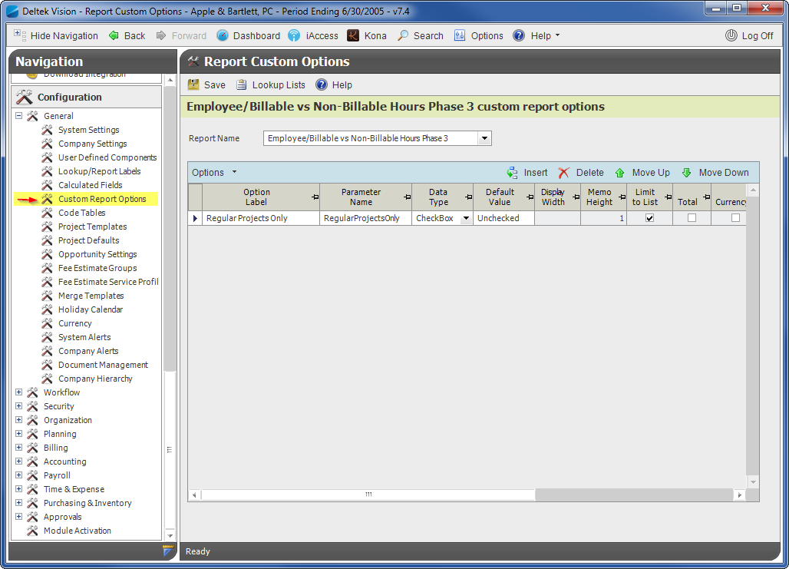
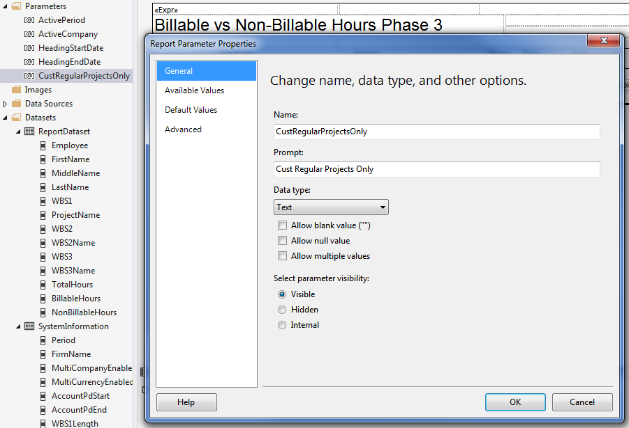
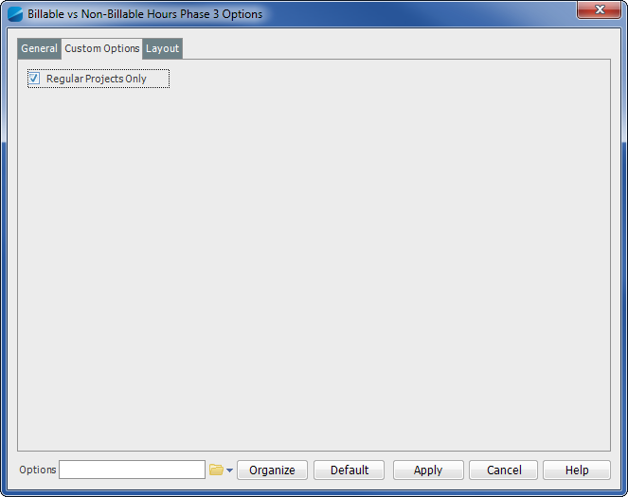
Phase 3 Demo

Slide 30
Using the Column Selection Feature
Show and hide report columns through the Options Dialog

Slide 31
Phase 4 Extensions
We want to add the ability show, hide and format report columns through the columns tab in the Options dialog
This needs changes in the designer only, no change to the SQL Statement necessary
Change the Custom Property UseColumnSelection to “Y”
You must follow a strict naming convention for each element in the Tablix table for this to work
Each column can be set to show by default. We need to apply the “Default” custom property to each header element and set it to “Y”

Slide 32
Column and Field Naming Conventions
Property | Description | Sample Value
DataElementName | All cells in a column have to share the same DataElementName to let Vision identify the related fields | EmployeeName
[Content of Header] | The content or Expression of the Text Box Element in the header will be used to display a heading value in the Options dialog box | Employee Name
DocumentMapLabel (in Header Row) | This is used if no value is set in the Header Content | Employee Name
Name | Each element name in a report must be unique. The prefix is used by Vision to look up and apply changes to the specific element. The suffix for all cells in a column must be the same | xxxxx_EmployeeName
Name (in Header Row) | Must always start with the header_ prefix | header_EmployeeName
Name (in Group Row) | Must always start with the group_ prefix | group_EmployeeName
Name (in Custom Group) | Never use group1, group2 as your group prefix. Always use proper naming | groupMyGroup_EmployeeName
Name (in Detail Row) | Must always start with detail_ prefix | detail_EmployeeName

Slide 33
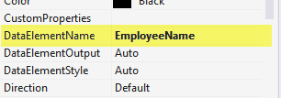
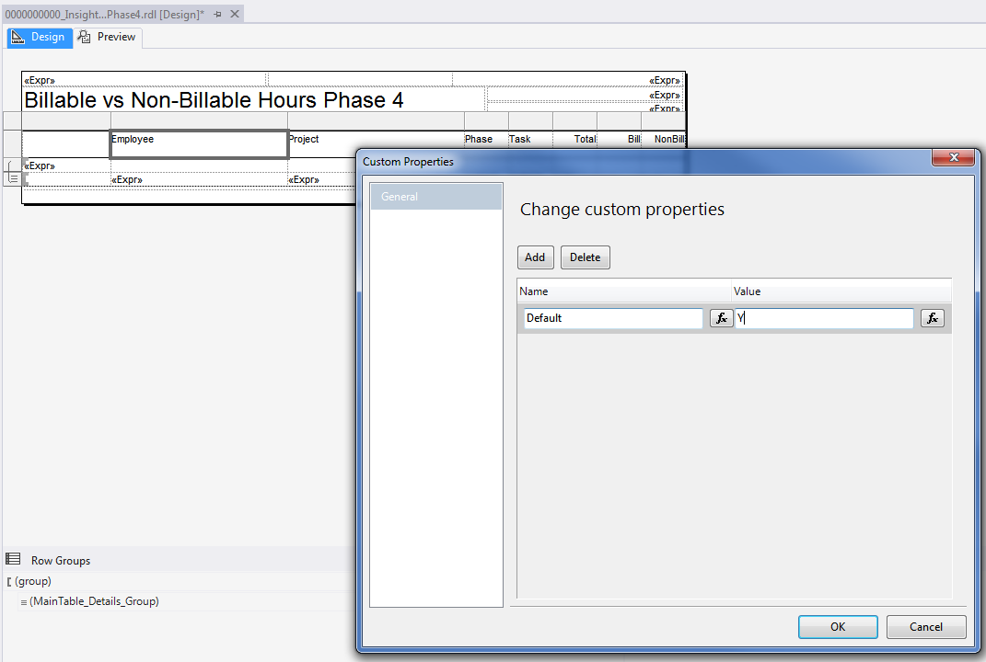
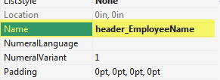
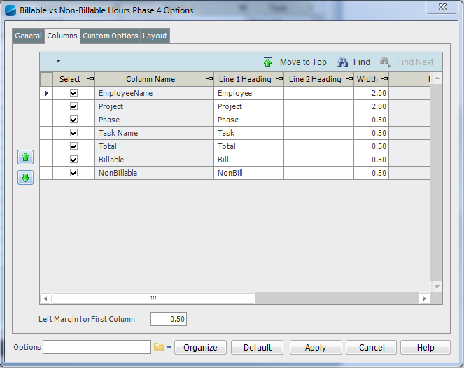
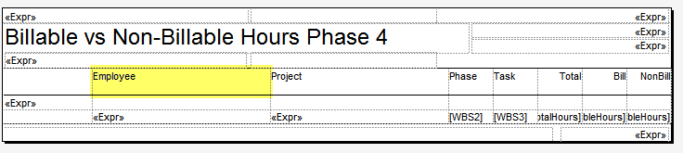
Phase 4 Demo

Slide 34
Using The Sorting/Grouping Feature
Add automated grouping and sorting to your custom report

Slide 35
Phase 5 Extensions
Add the /***GROUP COLUMNS***/, /***GROUP JOIN***/, /***GROUP CLAUSE***/ (or /***EXTEND GROUP CLAUSE***/) and /***ORDER CLAUSE***/, (or /***EXTEND ORDER CLAUSE***/) into the correct positions of the SQL Statement. Make sure your statement still works if new or additional groupings are added automatically!
Set the GroupingType to “Employee” and the AutoGroupQuery to “Y” in the report’s custom properties
If any totals should be shown for any column, the total calculation has to be placed in the predefined group header

Slide 36
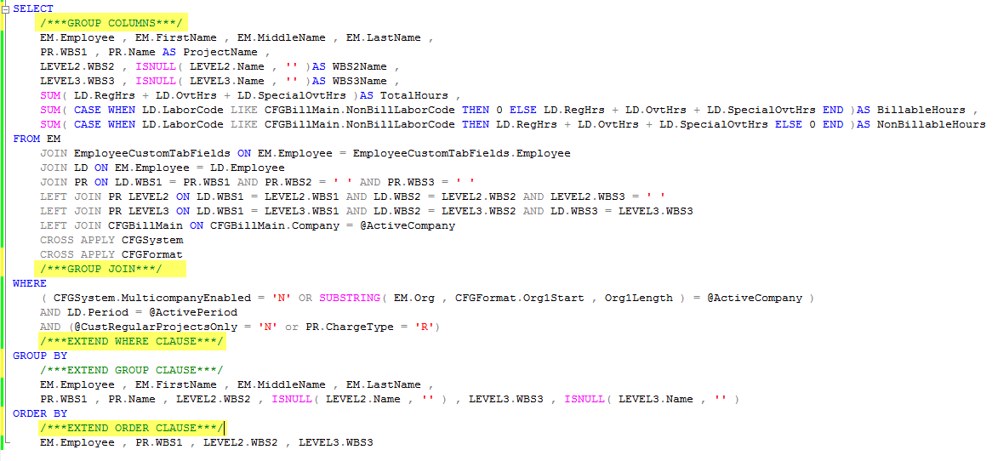
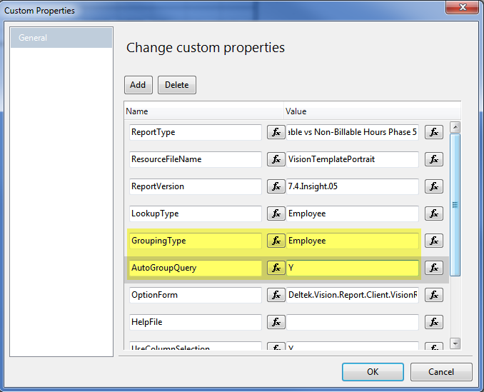
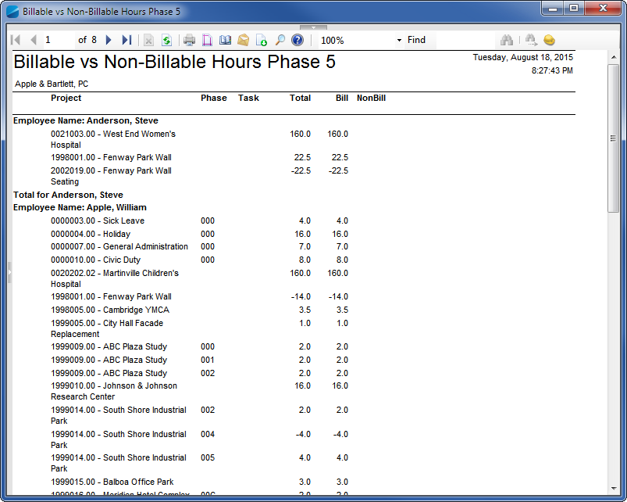
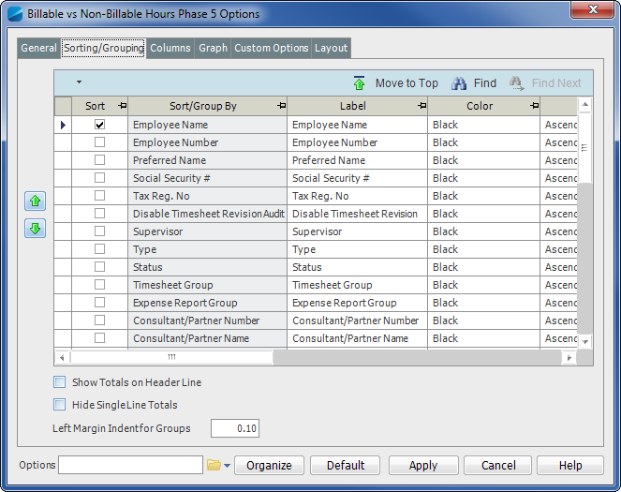
Phase 5 Demo

Slide 37
Other Custom Properties and Report Features

Slide 38
Additional Properties
AllowUserDefinedFields: set this property to the Info Center for which you want to show the fields (Employees, Projects, …). Make sure that the xxx_CustomTabFields is available in your SQL Statement and that the /***CUSTOM COLUMNS***/ placeholder is inserted after the SELECT keyword or the /***GROUP COLUMNS***/ keyword
AllowCalcFields: simply set it to “Y” to be able to add calculated fields to your custom report
Handling HTML text fields: some of the Vision text fields contain HTML formatted text (e.g. Timesheet comments). To display these correctly an additional custom property must be set for the text box called TextFormatType. The value must be set to HTMLFormat
Turning Off Backend Processing of the MainTable Tablix: if you are trouble shooting and want to make sure that Vision is not interfering with your report, set the custom property “SkipProcessing” on the MainTable element to “Y”

Slide 39
Project Reports and WBS Structure
Any report that is referring to projects and their WBS structure needs to implement a specific join clause in the FROM clause of the project. You can then add any additional tables to the SQL Statement. When referring to the project level, join to the PR table, when referring to the lowest available level refer to the LEVEL3 table
PR LEVEL3
INNER JOIN PR LEVEL2 ON
LEVEL2.WBS1 = LEVEL3.WBS1 AND LEVEL2.WBS2 = LEVEL3.WBS2 AND LEVEL2.WBS3 = ''
INNER JOIN PR ON
PR.WBS1 = LEVEL3.WBS1 AND PR.WBS2 = '' AND PR.WBS3 = ''

Slide 40
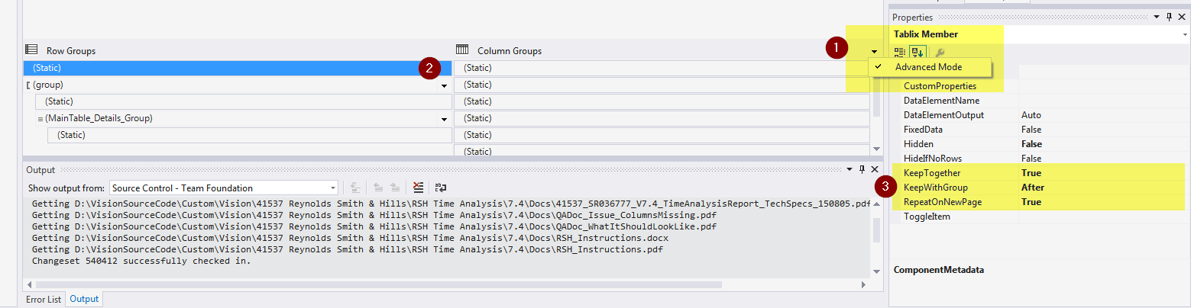
Show Table Header On All Pages
If the report should not repeat the header row on each new page check the following settings:
Click on the arrow in the Column Groups properties and select “Advanced Mode”
Pick the topmost Row Group and make sure the properties are set as listed below

Slide 41
Additional Resources

Slide 42
Links and Downloads
You can find all source code here: https://onedrive.live.com/redir?resid=57837B3F8462F61A!44568&authkey=!AC-oIqhaXVXz3N0&ithint=folder%2cpptx
All demos use the VisionDemo74 database (can be downloaded from the Deltek support site; http://support.Deltek.com )
I am available at the “Ask The Expert” sessions
Email me: Mike Dobler ( michaeldobler@Deltek.com )

Slide 43
Questions?

